Slide 1
St. Petersburg High School
International Baccalaureate Programme
IB Senior Meeting 2025

Slide 2
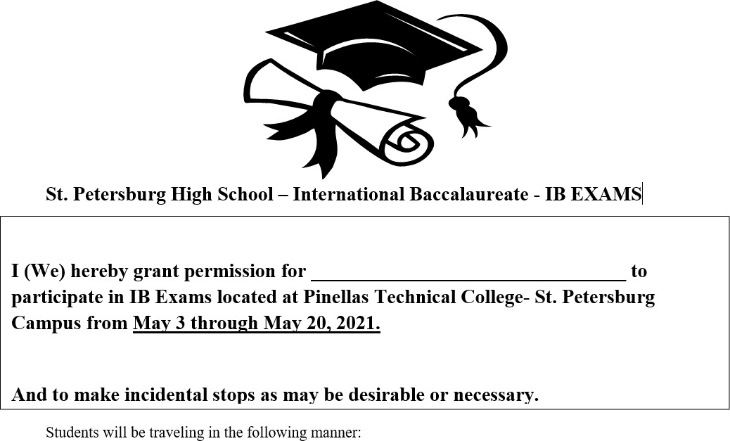
IB Exams Permission Forms
Senior Parents: Please complete the IB Exam TDE handout. Completed forms can be submitted in the personal information form and dropped off in the IB Office. Forms are due by Monday, April 14th, 2025.

Slide 3
Packing for the IB Exams
BRING:
Several #2 sharpened pencils (no mechanical pencils)
Black ink pens (NOT gel)
Erasers
Colored pencils for English Paper 1
Ruler (NOT provided), geometry instruments
Kleenex
Water in a CLEAR bottle- no labels on bottles
Jacket, sweat pants, socks
Calculator – See approved calculator list
Fresh batteries for calculator
NOTE: Items brought into testing MUST be in a clear plastic container (ziplock bag)
DO NOT BRING (leave in the trunk of your car)
Backpack
Books
Purse
Paper
Correction fluid or tape
Any electronic equipment, including cell phones, smart watches, smart glasses. They are not permitted in the exam room, we will not hold them for you.
*If you don’t have an approved calculator you must notify your math teacher BEFORE April 25th so you can check out a loaner. We do not guarantee we will have a loaner calculator at the testing site if you forget yours or the batteries die.

Slide 4
The Day of the Examination
Students must arrive at the campus on time.
Restroom breaks are permitted during testing. Students leaving the testing area will be accompanied by an invigilator. Only one student may leave the testing area at a time, and they will sign in and out.

Slide 5
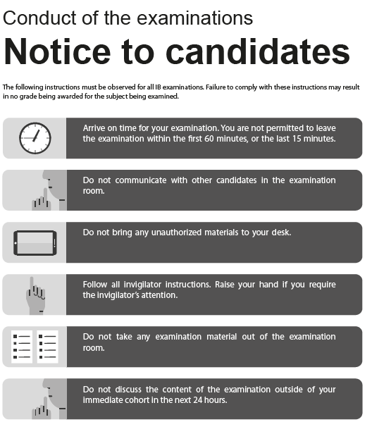
Conduct of the Examination Notice to Candidates
The full document is posted on the Senior Meeting webpage and Managebac.

Slide 6
Use of Calculators in Examinations
Recommended Calculators: Please use the TI-84+ graphing calculator or the TI-Nspire (Non-CAS version) with the most updated operating system. See your current math teacher to ensure you have the latest operating system.
*Please make sure your graphing calculator is charged or has fresh batteries for each exam day.
For TI-84 Students:
Before Day of Exam using a calculator:
Reset Archive Vars (if applicable)
Remove all Flash (ROM) applications except Finance, PolySmit, and PlySmlt2. (Your Math teacher will help you.)
On Day of Exam
You must reset your RAM Memory before each Exam that allows a calculator. Steps will be reviewed during class, but they are,
₂nd
+ 7 1 2
**To enter the exam room, show the proctor your RAM Cleared screen
For TI-Nspire Students:
Your Calculator must be in press to test mode with specific configurations. Please see your math teacher prior to end of April to learn what configurations are allowed, and be ready to show the exam proctor the correct configuration mode each time you are testing, so that you can use the Nspire calculator during testing. This process must be done before each exam.

Slide 7
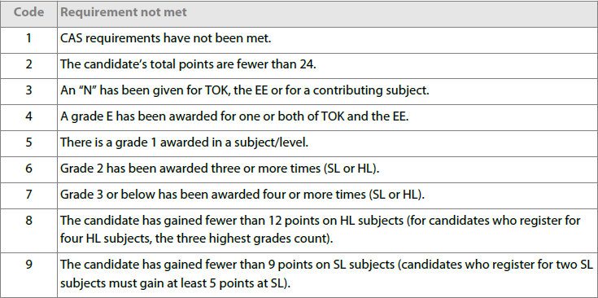
What It Takes to Earn the IB Diploma

Slide 8
What It Takes to Earn the IB Diploma
Complete CAS
Complete EE
12 total HL Points
9 total SL Points

Slide 9
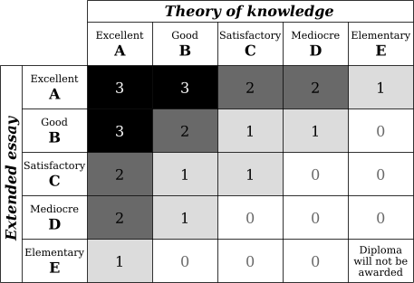
Will this individual get a diploma?
Course | Level | Grade
English A | HL | 4
Spanish B | SL | 3
Chemistry | SL | 3
Chemistry | EE | B
Physics | HL | 4
Psychology | HL | 4
Math Analy/Apps | SL | 4
Theory of Knowledge |  | B
Total HL = 12
Total SL = 10
Total Points = 22
Needed for Diploma = 24
Extra Points (TOK EE) = 2

Slide 10
How to Access Your Results
May 2025
Event
July 6, 2025
Component marks and grades are published on IBIS.

Slide 11
Life After Exams
ENQUIRY UPON RESULTS
You may request a re-mark of an externally assessed material (exam, EE). A request for an enquiry upon results will only be accepted from schools, not from individual candidates, their legal guardian or other representatives. A re-marking does not include multiple choice components (MCQ) and internal assessments. A request for an enquiry upon results must be submitted no later than September 15th.
RETAKING AN IB EXAM
The deadline for registration and payment of a candidate from May 2025 session retaking one or more subjects in November 2025 is July 29th. The cost is $172.00 registration fee plus $119.00 per subject exam. Cost for TOK is registration fee plus $46.00 and EE is registration fee plus $91.00.
Parents are also responsible for any mailing fees.

Slide 12
Additional Documents
Credit by Equivalencies for in-state public schools for IB exam scores
Complete document is on the Senior Meeting webpage.
IB Exam Schedule
TDE

Slide 13
Important Dates
April 1st: Mandatory senior class meeting at 6pm
April 3rd: Cap and Gown Delivery- Gym Lobby- For attendance purposes, please check in with your fourth period teacher!
April 4th: Prom at The Coliseum- 8pm-12am
April 11th: Grad Bash-Universal Studios
April 14th- 17th: SENIOR WEEK
Monday: Senior Sunrise
Tuesday: Decision Day
Wednesday: Move Up Assembly
Thursday: Drive In Movie Night
April 25th: Last day for IB Physics Students ONLY
May 2nd: Last day for ALL OTHER IB Seniors
May 21st IB Senior Celebration Dinner- Coliseum
All Seniors and their families are invited!
April 25th - May 17th: IB testing session
(see testing calendar for locations and times)
May 29th: Graduation at Baycare Sound in Clearwater 7:30 pm
TBA: Yearbook Distribution
July 6th: IB Exam results available at https://candidates.ibo.org

Slide 14
IB Senior Fees (Due by April 22)
Senior IB Graduation Fees ($45) and include:
IB sash
IB diploma mailing to student

Slide 15
IB Senior Celebration Information
Date: May 21st, 6:00 pm – 9:00 pm
Cost: TBD
Dress: Business casual. No shorts, flip flops etc.
Information will be coming with how to purchase meals, tribute pages in the program, etc.
There will be entertainment and dinner

